Slide 1
Tap tap revolution
Anthea li
Period 6
6/6/17

Slide 2
introduction
Dance Dance Revolution remake modified for keyboard
Created with Python (pygame)
Notes:
Pygame - cross-platform set of Python modules designed for writing video games

Slide 3
features
Arrows moving across the screen
Player must press the respective arrow key when the arrows match up
Earn points
30 second timer
Pause and Game Over screen

Slide 4
Original goal
Create “Tap Tap Revolution” with Python
Make game multiplayer over a server with socket.io
Unable to achieve goal due to time crunch
Notes:
Python implementation of the event-driven realtime server socket.io

Slide 5
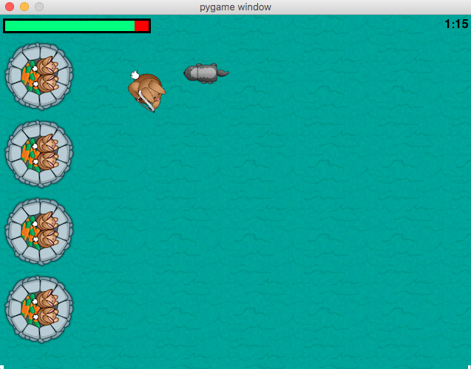
Procedure
Followed a guide to create a simple pygame game
Learned how to “animate” elements across the game window
Learned how to implement a timer
Learned how to print text onto the screen
Used trig and calculus to calculate the direction projectiles would be shot at

Slide 6
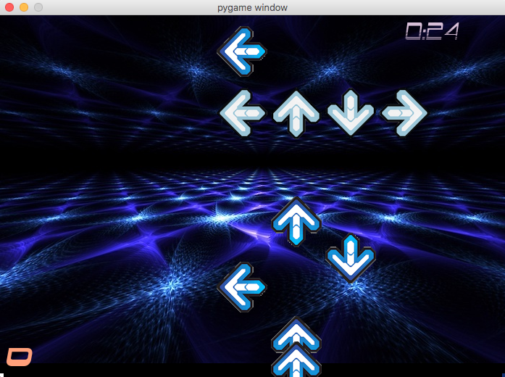
procedure
Create background of game window
Arrow keys event listeners
Pause feature
Score counting and Game Over screen
Notes:
DEMONSTRATION AFTER THIS SLIDE

Slide 7
challenges
Arrows wouldn’t disappear
Can’t remove items from a list while iterating over it
List comprehension
list[:] = [x for x in list if (x % 2 == 0)]
All the arrows would disappear (very hard to fix)
Use an array for all arrows, and then one for each direction of arrow (total of 5)
For some reason accessing the direction attribute of the Arrow class didn’t work
Game Over Screen
Tried putting game over command within the main loop, didn’t work because it would appear for one frame and disappear
Modified code to fit game over command inside the main loop
Overall, didn’t really have human help
Notes:
A list comprehension is a line of code that creates a new list that only retains the items that meet a certain condition.

Slide 8
What I would have done differently
Not spend so much time on the introduction project
Didn’t really use most of the concepts I learned from it like implementing trig and calculus
Biggest resource I ended up using was stackoverflow

Slide 9
Further improvement
Add a beginning screen where player could choose difficulty level or music
Add music
Scoreboard showcasing high scores
Make multiplayer

Slide 10
Purpose of this project
Allow me to learn a new programming language as well as the basics of game programming
Give people a chance to enjoy DDR without needing an entire machine
Furthered my interest in game programming and computer science in general

